Slide 1
Figures | Ft. Lauderdale Office | Q1 2026
  Fort Lauderdale Offices See Firming Rents Amid Suburban Space Givebacks
Copy and paste one of these arrows into the “add arrow” picture boxes as needed. They are vector objects that will perfectly fill the space.
18.6%
(83,163)
0
176,500
$28.16
  Vacancy Rate
  SF Net Absorption
  SF Construction Delivered
  SF Under Construction
  NNN/YR Direct Lease Rate
Market Overview
Figure 1: Historical Net Absorption, Deliveries, and Vacancy​
The office market in Q1 2026 showed softer quarterly activity but continued multi-year tightening in vacancy despite demand volatility. Vacancy increased 30 basis points quarter-over-quarter to 18.6% but remained 10 basis points below Q1 2025 and 130 basis points below Q1 2023. This was due to a few large move outs in the western Broward suburban submarkets.
Pricing continued to move higher. The average asking rate reached $28.16 per sq. ft. in Q1 2026, up 2.6% quarter-over-quarter, 6.9% year-over-year, and approximately 21.8% above Q1 2020. Construction remained modest, with 177,000 sq. ft., in Fat Village which is being developed by Hines, under way and no new deliveries since the 50,000 sq. ft. Southeast Broward building completed in Q3 2023. The last major office delivery was Optima Onyx which delivered 300,000 sq. ft. in 2021.
Overall, Q1 2026 was characterized by sustained rent growth and some negative large block absorption. The market did see modest improvement in availability over the past year and there is limited new supply in the pipeline.
Source: CBRE Research, Q1 2026

Slide 2
Vacancy
Figure 2: Vacancy Rates by Class​
Total vacancy in Class A buildings edged up 20 bps quarter-over-quarter to 18.2% in Q1 2026, while Class B vacancy increased 70 bps to 19.3%. Year-over-year, Class A vacancy decreased 80 bps from 19.0%, but Class B rose 110 bps from 18.2%. Direct vacancy in Class A fell 30 bps QoQ and 70 bps YoY to 16.0%, whereas Class B direct vacancy climbed 60 bps QoQ and 120 bps YoY to 18.3%. Sublease vacancy in Class A moved up 40 bps QoQ to 2.2% but remains 10 bps below a year earlier; Class B sublease vacancy held at 1.0%, flat QoQ and 10 bps lower YoY. The Class A–B vacancy spread has inverted over the past year, with Class B now 110 bps more vacant than Class A versus an 80 bps Class A premium in Q1 2025. Broward’s lower Class A vacancy rates reflect a nationwide drive to quality for office space.
Sublease availability totals 763,900 sq. ft. across the market, holding relatively steadily at 3.1% sublease availability but down significantly from the post-pandemic peak in Q2 2021 when sublease availability stood at 1,061,700 sq. ft. or 4.1%.
Source: CBRE Research, Q1 2026
Asking Rent
Figure 3: Average Direct Asking Rate by Class​
The overall average direct asking rate in Q1 2026 is $28.16 per sq. ft., up 2.6% from the prior quarter and 6.9% year-over-year. Class A office asking rents increased from $30.57 per sq. ft. to $31.10 per sq. ft. quarter-over-quarter and are up 6.2% year-over-year, modestly trailing overall market rent growth. Class B asking rents reached $22.52 per sq. ft., rising 4.1% quarter-over-quarter and 6.9% year-over-year.
Fort Lauderdale CBD records the highest average direct asking rate on record for Class A buildings reaching $42.16 per sq. ft. this quarter with multiple buildings pushing rents on available spaces.
Source: CBRE Research, Q1 2026

Slide 3
Net Absorption​
Figure 4: Net Absorption Trend​
Net absorption in Q1 2026 turned negative after three consecutive quarters of positive absorption 83,000 sq. ft.. This was largely focused in the west Broward suburban markets. The two largest move outs were UKG in Weston and Benelynk in Sunrise. Positive net absorption in Q1 2026 was concentrated primarily in the Fort Lauderdale CBD Class A submarket with 27,000 sq. ft. for the quarter driven by move-ins at 401 E Las Olas and 500 E Broward.
Source: CBRE Research, Q1 2026
Construction Activity​
Figure 5: Construction Activity
Office construction stood at 177,000 sq. ft. under construction in Q1 2026, with no new space delivered during the quarter. This total has been unchanged since Q1 2025, leaving construction volume flat quarter‑over‑quarter and year‑over‑year, and deliveries at 0 sq. ft. over the same period. All space underway in the market totals is Class A, with no Class B projects reported under construction.
In the submarket detail, Fort Lauderdale CBD records 176,500 sq. ft. of Class A space under construction at T3 FAT Village East, which is 0.0% pre‑leased as of Q1 2026 and expected to deliver in late 2026.
Source: CBRE Research, Q1 2026

Slide 4
Leasing Activity
Figure 6: Leasing Activity Trend (Activity 10,000 sq. ft. or greater)
Leasing activity totaled 466,700 sq. ft. in Q1 2026, while rolling four-quarter volume reached 2.3 million sq. ft. The rolling four-quarter total decreased 6,100 sq. ft., or 0.3%, from Q4 2025 and increased 39,500 sq. ft., or 1.8%, versus Q1 2025. Class A assets captured 1,520,700 sq. ft., or 67.4% of the past year’s leasing, with Class B space accounting for 736,400 sq. ft., or 32.6%.
At the submarket level, Fort Lauderdale CBD recorded the highest Q1 2026 leasing volume at 134,500 sq. ft., while Plantation and Cypress Creek were the next most active, with 125,200 sq. ft. of deals and 88,100 sq. ft. respectfully.
Source: CBRE Research, Q1 2026
Figure 7: Leasing by Submarket (% of Total Activity 10,000 sq. ft. or greater)
Figure 8: Key Lease Transactions
Tenant | Sq. Ft. Leased | Transaction Type | Address | SubmarketCio
Confidential Global Shipping Company | 110,000 | Renewal | 1210 S Pine Island Rd | Plantation
Uniforms Direct | 26,000 | Renewal | 101 NE 3rd Ave | Fort Lauderdale CBD
Broward Metropolitan Planning Organization | 20,000 | Renewal | 100 W Cypress Creek Rd | Cypress Creek
Tabacalera S.L.U. | 20,000 | Renewal | 5900 N Andrews Ave | Cypress Creek
ReturnPro | 15,000 | New Lease | 1010 S Federal Hwy | Southeast Broward
City of Ft Lauderdale | 13,000 | New Lease | 101 NE 3rd Ave | Fort Lauderdale CBD
Capital Collateral | 13,000 | Renewal | 110 SE 6th St | Fort Lauderdale CBD
Travelers Insurance | 12,000 | Renewal | 3230 W Commercial Blvd | Cypress Creek
Source: CBRE Research, Q1 2026
Source: CBRE Research, Q1 2026

Slide 5
Market Statistics
Figure 9: Suburban Market Statistics by Class
Property Class | Net Rentable Area (MSF) | Total Vacancy (%) | Total Availability (%) | Direct Availability (%) | Sublease Availability (%) | Current Quarter Net Absorption (SF) | YTD Net Absorption (SF) | Deliveries (SF) | Under Construction (SF) | Avg. Direct Asking Rate ($/SF NNN/yr)
Class A | 10.56 | 18.6 | 26.1 | 22.3 | 3.8 | (51,000) | (51,000) | - | - | 25.87
Class B | 8.94 | 19.6 | 22.5 | 20.2 | 2.3 | (54,000) | (54,000) | - | - | 22.22
Total | 19.50 | 19.1 | 24.4 | 21.3 | 3.1 | (105,000) | (105,000) | - | - | 24.36
Source: CBRE Research, Q1 2026
Figure 10: Urban Market Statistics by Class
Property Class | Net Rentable Area (MSF) | Total Vacancy (%) | Total Availability (%) | Direct Availability (%) | Sublease Availability (%) | Current Quarter Net Absorption (SF) | YTD Net Absorption (SF) | Deliveries (SF) | Under Construction (SF) | Avg. Direct Asking Rate ($/SF NNN/yr)
Class A | 4.45 | 17.1 | 23.4 | 19.9 | 3.6 | 27,000 | 27,000 | - | 177,000 | 43.38
Prime | 0.37 | 0.6 | 7.5 | 0.6 | 6.9 | - | - | - | - | -
Other Class A | 4.08 | 18.6 | 24.9 | 21.6 | 3.3 | 27,000 | 27,000 | - | 177,000 | 43.38
Class B | 0.40 | 12.4 | 22.5 | 21.6 | 0.9 | (5,000) | (5,000) | - | - | 28.16
Total | 4.85 | 16.7 | 23.4 | 20.0 | 3.3 | 22,000 | 22,000 | - | 177,000 | 42.16
Source: CBRE Research, Q1 2026
Figure 11: Metro Market Statistics by Class
Property Class | Net Rentable Area (MSF) | Total Vacancy (%) | Total Availability (%) | Direct Availability (%) | Sublease Availability (%) | Current Quarter Net Absorption (SF) | YTD Net Absorption (SF) | Deliveries (SF) | Under Construction (SF) | Avg. Direct Asking Rate ($/SF NNN/yr)
Class A | 15.01 | 18.2 | 25.3 | 21.6 | 3.7 | (24,000) | (24,000) | - | 177,000 | 31.10
Prime | 0.37 | 0.6 | 7.5 | 0.6 | 6.9 | - | - | - | - | -

Slide 6
Property Class | Net Rentable Area (MSF) | Total Vacancy (%) | Total Availability (%) | Direct Availability (%) | Sublease Availability (%) | Current Quarter Net Absorption (SF) | YTD Net Absorption (SF) | Deliveries (SF) | Under Construction (SF) | Avg. Direct Asking Rate ($/SF NNN/yr)
Other Class A | 14.64 | 18.6 | 25.7 | 22.1 | 3.6 | (24,000) | (24,000) | - | 177,000 | 31.10
Class B | 9.34 | 19.3 | 22.5 | 20.3 | 2.2 | (59,000) | (59,000) | - | - | 22.52
Total | 24.35 | 18.6 | 24.2 | 21.1 | 3.1 | (83,000) | (83,000) | - | 177,000 | 28.16
Source: CBRE Research, Q1 2026

Slide 7
Market Statistics by Submarket
Figure 12
Submarket | Net Rentable Area (MSF) | Total Vacancy (%) | Total Availability (%) | Direct Availability (%) | Sublease Availability (%) | Current Quarter Net Absorption (SF) | YTD Net Absorption (SF) | Deliveries (SF) | Under Construction (SF) | Avg. Direct Asking Rate ($/SF NNN/yr)
Cypress Creek | 5.48 | 16.5 | 25.4 | 23.1 | 2.3 | 5,000 | 5,000 | - | - | 21.95
Fort Lauderdale CBD | 4.85 | 16.7 | 23.4 | 20.0 | 3.3 | 22,000 | 22,000 | - | 177,000 | 42.16
Northeast Broward | 1.36 | 17.1 | 18.8 | 16.1 | 2.6 | (2,000) | (2,000) | - | - | 22.94
Northwest Broward | 0.84 | 20.4 | 25.7 | 19.3 | 6.4 | (3,000) | (3,000) | - | - | 23.18
Plantation | 3.47 | 13.4 | 15.2 | 14.7 | 0.5 | (9,000) | (9,000) | - | - | 27.30
Sawgrass Park | 2.92 | 27.2 | 30.3 | 25.7 | 4.6 | (53,000) | (53,000) | - | - | 22.97
Southeast Broward | 2.53 | 21.1 | 23.3 | 20.6 | 2.7 | 5,000 | 5,000 | - | - | 28.69
Southwest Broward | 2.88 | 21.3 | 31.0 | 25.3 | 5.6 | (47,000) | (47,000) | - | - | 25.89
Total | 24.35 | 18.6 | 24.2 | 21.1 | 3.1 | (83,000) | (83,000) | - | 177,000 | 28.16
Source: CBRE Research, Q1 2026

Slide 8
Economic Overview
The current business cycle may be five years old, but U.S. growth appears resilient, despite clear risks on the horizon. GDP growth should average 2.1%, matching 2025 and exceeding peer economies. America’s aggressive build-out of AI infrastructure is a unique edge. Hyperscaler capex is nearing 3% of GDP—just below residential investment. Concerns about the sustainability of this growth and its broader impact are rattling both credit and equity markets. Operation Epic Fury and global energy prices are also a concern. Assuming the conflict is resolved quickly, and U.S. oil prices stay in the $80/bbl range, the impact on U.S. growth should be minimal. The impact on headline inflation, which is forecast to average 3.2% this year, up from the mid-2% range in February, will be material. Should the conflict escalate, this would elevate inflation and long-term yields and would likely impact the commercial real estate market.

Slide 9
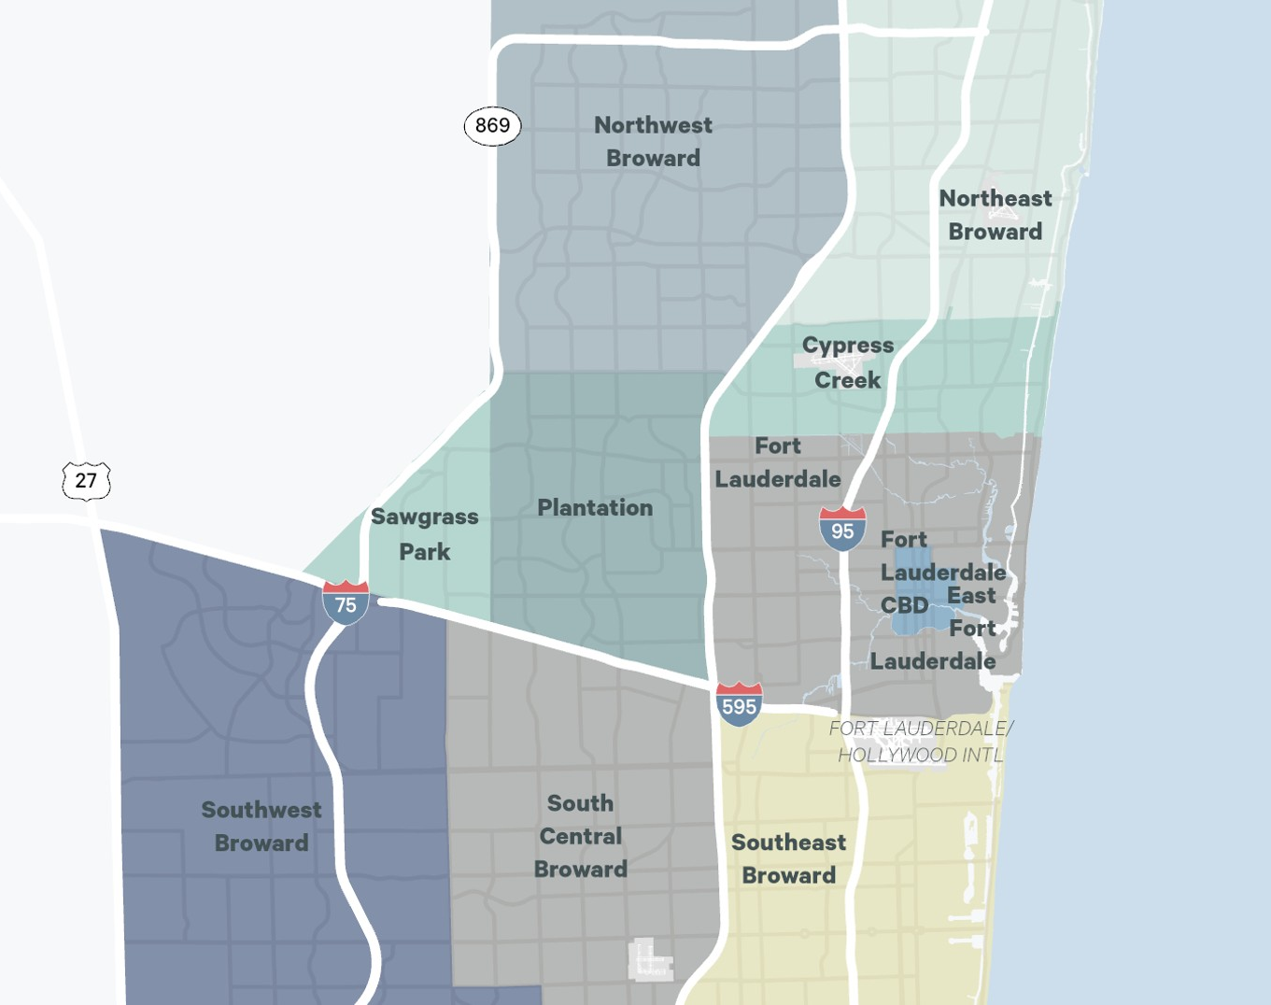
Portrait Map option.
If need to resize, turn on View>Guides to align frame to underlying grid.
Definitions
  Available Sq. Ft.: Space in a building, ready for occupancy within six months; can be occupied or vacant. Availability Rate: Total Available Sq. Ft. divided by the total building Area. Average Asking Lease Rate: A calculated average that includes net and gross lease rate, weighted by their corresponding available square footage. Building Area: The total floor area sq. ft. of the building, typically taken at the “drip line” of the building. Gross Activity: All sale and lease transactions completed within a specified time period. Excludes investment sale transactions. Gross Lease Rate: Rent typically includes real property taxes, building insurance, and major maintenance. Net Absorption: The change in Occupied Sq. Ft. from one period to the next. Net Lease Rate: Rent excludes one or more of the ”net” costs (real property taxes, building insurance, and major maintenance) typically included in a Gross Lease Rate. Occupied Sq. Ft.: Building Area not considered vacant. Vacancy Rate: Total Vacant Sq. Ft. divided by the total Building Area. Vacant Sq. Ft.: Space that can be occupied within 30 days. Class A industrial are buildings built after 2000, with 32’ or greater clear height and ESFR sprinklers.
Survey Criteria
Includes all competitive Class A and Class B office buildings 30,000 sq. ft. and greater in size in Broward County. Beginning Q1 2022, single tenant non-owner-occupied buildings have been added to the set and their inclusion is reflected historically in the data. Excludes: government and medical buildings..
Gian Rodriguez
  Senior Managing Director
  gian.rodriguez@cbre.com
Marc L. Miller
  Research Director
  marc.miller1@cbre.com
Ilyssa Ettelman
  Research Manager
  Ilyssa.ettelman@cbre.com
Elliott Kramer
  Research Analyst
  elliott.kramer@cbre.com
Make sure © year is correct on
all back cover layout options
© Copyright 2026 All rights reserved. Information contained herein, including projections, has been obtained from sources believed to be reliable, but has not been verified for accuracy or completeness. CBRE, Inc. makes no guarantee, warranty or representation about it. Any reliance on such information is solely at your own risk. This information is exclusively for use by CBRE clients and professionals and may not be reproduced without the prior written permission of CBRE’s Global Chief Economist.

